Slide 1

Override Hold Policies
Idea Exchange
Yoel Kortick | June 2026

Slide 2
Agenda
  Introduction
  Using the new feature
  An example after this development
  Summary

Slide 3
Introduction

Slide 4
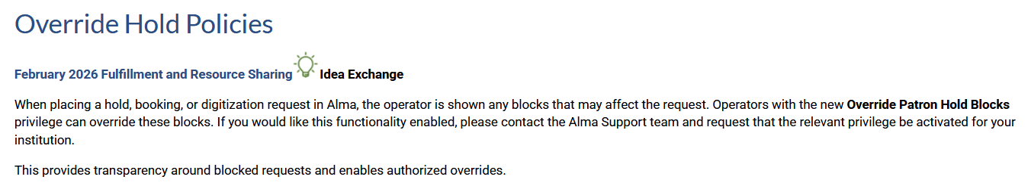
Introduction

Slide 5
Introduction
When placing a hold, booking, or digitization request in Alma, the operator is shown any blocks that may affect the request.
Operators with the new Override Patron Hold Blocks privilege can override these blocks.
Institutions can get this functionality enabled by contacting Alma Support and requesting that the relevant privilege be activated for your institution.
This provides transparency around blocked requests and enables authorized overrides.
This development includes the addition of a “Calculate Blocks” button (which did not exist before this development) as well as an option to override the blocks.

Slide 6
Using the new feature

Slide 7
Using the new feature
The institution has contacted Ex Libris support and asked that the new privilege "Override Patron Hold Blocks" be added to the following roles:
  Circulation Desk Manager
  Fulfillment Services Manager

Slide 8
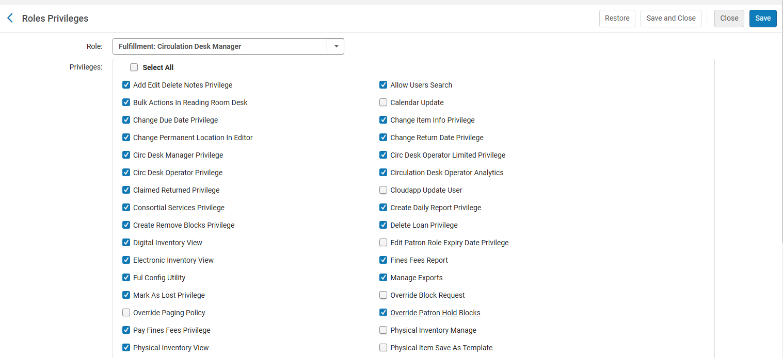
Using the new feature
The new privilege "Override Patron Hold Blocks" is added to role "Circulation Desk Manager"

Slide 9
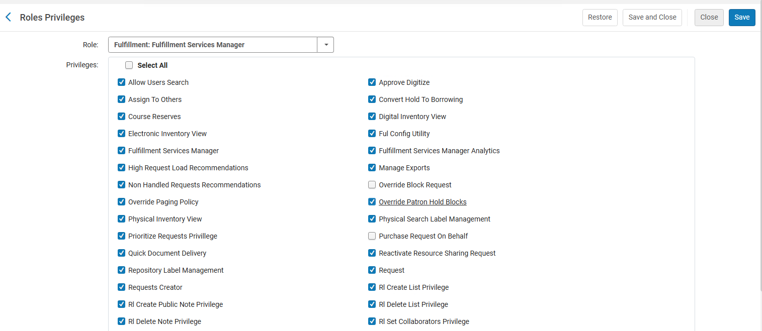
Using the new feature
The new privilege "Override Patron Hold Blocks" is added to role "Fulfillment Services Manager"

Slide 10
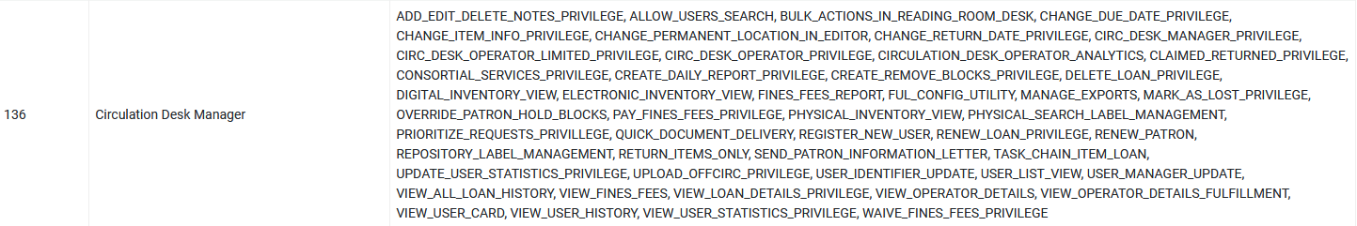
Using the new feature
At "Configuration > User Management > Roles and registration > Privileges Report" the institution can see that privilege "Override Patron Hold Blocks" was added to role "Circulation Desk Manager"

Slide 11
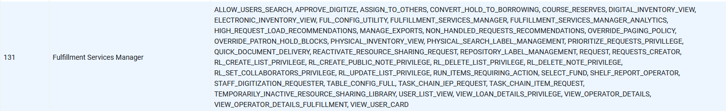
Using the new feature
At "Configuration > User Management > Roles and registration > Privileges Report" the institution can see that privilege "Override Patron Hold Blocks" was added to role "Fulfillment Services Manager"

Slide 12
An example after this development

Slide 13
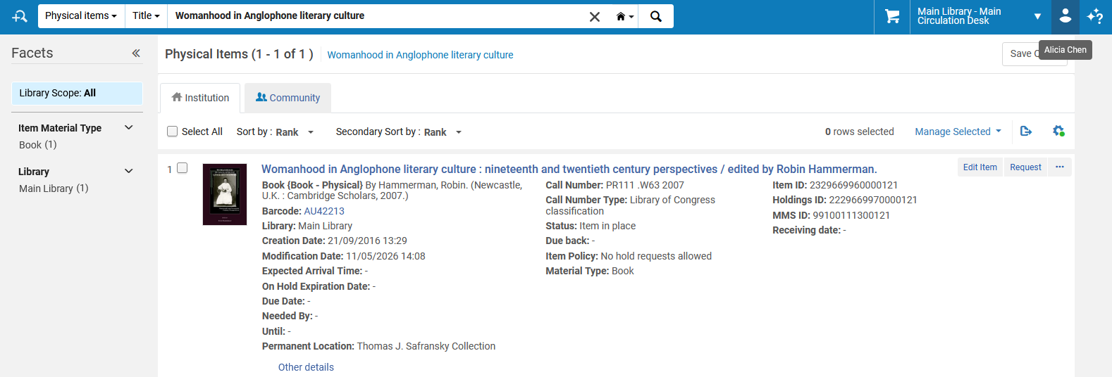
An example after this development
Staff user Alicia Chen will try to make a request for title "Womanhood in Anglophone literary culture" for patron Caroline Devue

Slide 14
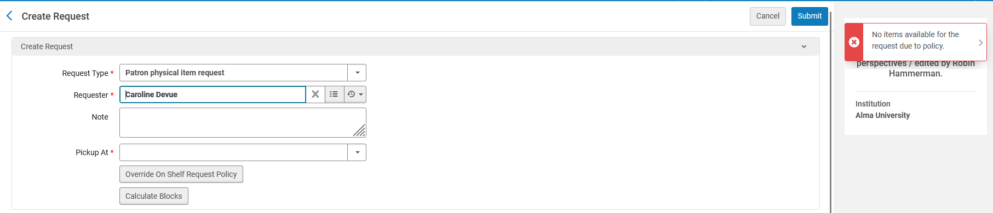
An example after this development
Staff user Alicia Chen gets message "No items available for the request due to policy".
The staff user will click "Calculate Blocks"
This is the new “Calculate Blocks” button

Slide 15
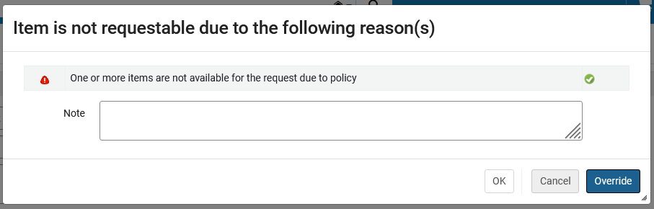
An example after this development
After clicking "Calculate Blocks" the staff user receives the following message, with an option to override. We will click the "Override" option (because the staff user has a role with the override privilege).
An option to override

Slide 16
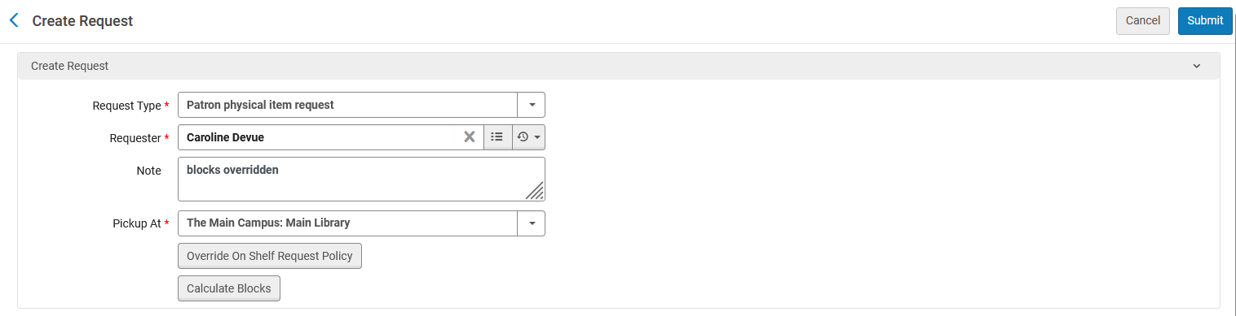
An example after this development
A note "blocks overridden" is added to the request.
We can add a pickup location and submit the request.

Slide 17
Summary

Slide 18
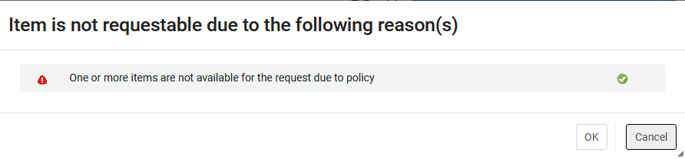
Summary
When privilege "Override Patron Hold Blocks" is not added to the following roles: "Circulation Desk Manager" and "Fulfillment Services Manager" then after clicking "Calculate Blocks" there is no option to override the block.
There is no option to override the block

Slide 19
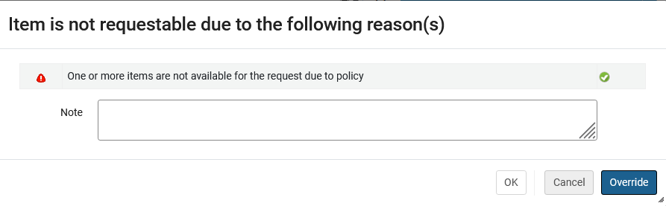
Summary
When privilege "Override Patron Hold Blocks" is added to the following roles: "Circulation Desk Manager" and "Fulfillment Services Manager" then after clicking "Calculate Blocks" there is an option to override the block. When clicked, a note "blocks overridden" is added to the request, the staff user can add a pickup location and submit the request.

